Slide 1

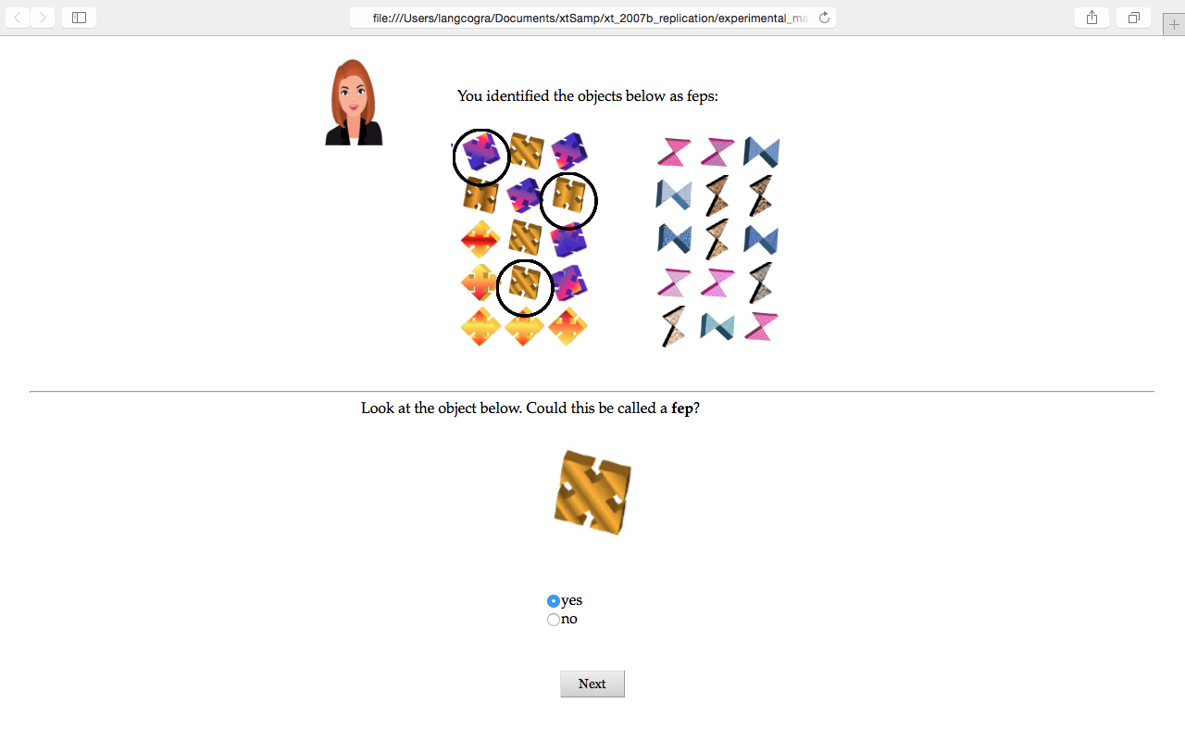
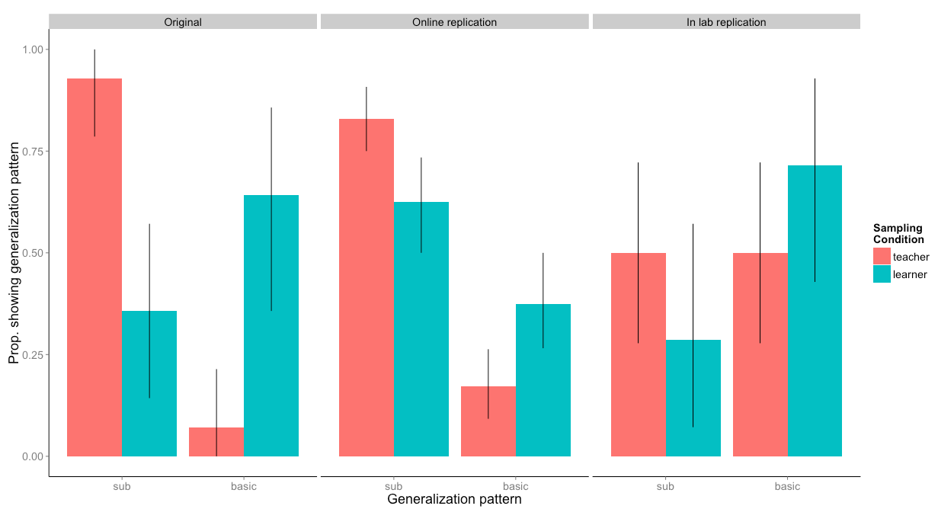
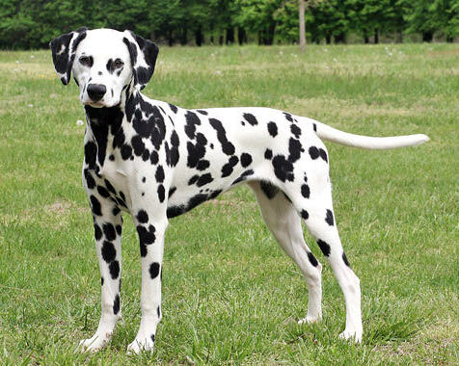
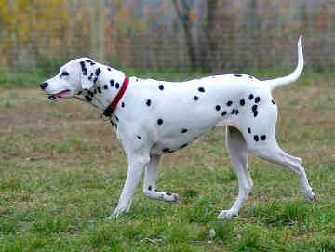




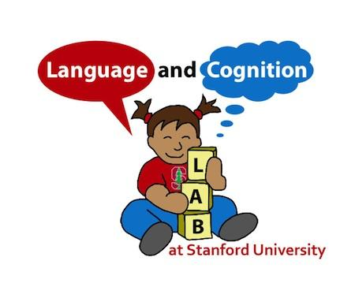


Learning Context Influences Generalizations in Word Learning
Marlene Ade, Molly Lewis, Michael C. Frank
Language and Cognition Lab, Psychology Department
Introduction
Experiments
Results
Fep
Feps
What do you think “fep” means?
Two common word learning models:
Associate inference and Rational inference
Xu and Tenenbaum 2007b found that how examples were generated (“sampled”) influenced how children and adults generalized word meanings.
In particular, generalized more narrowly when the examples came from a knowledgeable teacher, than when generated by a learner.
Participants:
42 participants recruited in lab
200 participants on Amazon Mechanical Turk
Procedure:
Training Phase: Participant sees three exemplars of novel word then awarded a sticker. Presentation context depends on sampling condition
Testing Phase: Participant asked “Is this a fep?” for 3 exemplar types:
subordinate basic non-match
The online replication included an additional 10 stimuli-type questions and 4 filter questions.
Conclusion
We replicate the original finding suggesting that sampling context influences generalization patterns in word learning
We replicate the effect both in an in lab and online study
However, the effect size was much smaller than the original study
Higher-rate of non-subordinate selections in learner condition
Future Directions:
Manipulate spatial organization of two basic level categories
Prevent feedback from the experimenter in the learner-driven condition
Include a within subject replication
Teacher-driven Strong sampling; teacher points to three different examples of stimuli in the same subordinate group. | OR | Learner-driven Weak sampling; experimenter points to one example of the subordinate stimuli and the participant must point to the other two (subordinate) examples.
Acknowledgements
A very special thank you to my mentor Molly Lewis and my PI Michael C. Frank for taking their time to help me throughout the summer. Thank you to the American Psychology Association and Stanford University for funding and allowing me to take part in this research.
The present study was an in lab and online replication of Xu and Tenenbaum 2007b.
Notes:
should I include the excluded participants or just say that? - How about: Learning context influences generalization in word learning?
Do you want to stop by real quick and we can chat about this?
fix the aspect ratio of teacher
Figure 1: The results from the original and online data strongly show that those in the teacher’s condition generalize to the subordinate level more. The results of the original and in lab show that those in the learner’s condition generalize to the basic level more often.

